Slide 1





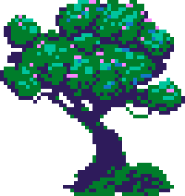





CAT
GAME

Slide 2

Meet The Team
Ibrahim Al-Zubaidi
202210902
Jana Ellayan
202311520

Slide 3
Gameplay
The program begins with a welcome screen, the menu page, allowing you to either log in, sign up or view leaderboards.
You’re redirected to a page that either takes input from you or shows you the highscores.

Slide 4
Gameplay
These pages are connected to a database carefully crafted to store players usernames and their scores. It also updates and ranks users with each run if needed.

Slide 5
Gameplay con.
After registering, the game page starts and you can move the character forwards and backwards, and jump using WASD and space bar.

Slide 6
Result
Ended up with a fully functioning 2D Platformer game, with pretty visuals and amazing database.
This project allowed us to sharpen our Java skills, as well as database, artistic, mathematical skills and get better at teamwork!
We enjoyed working on it, seeing stupid bugs and collaborating.

Slide 7
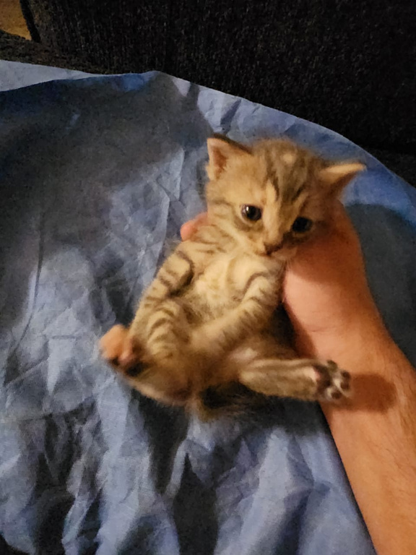
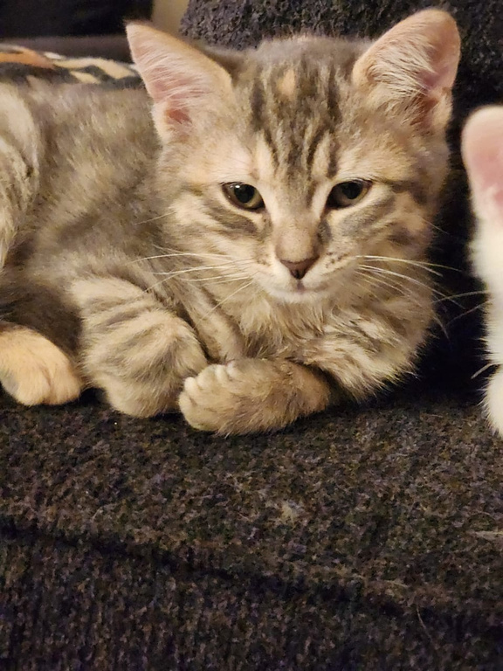
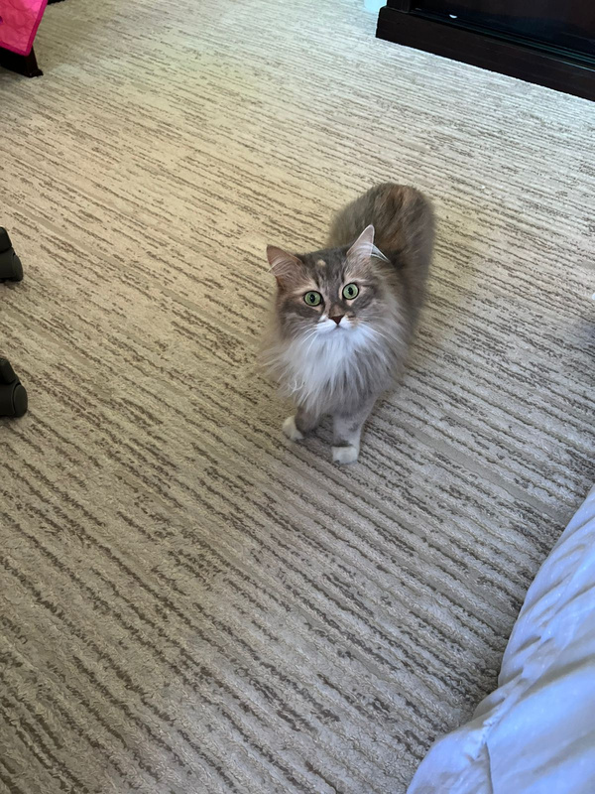
Honorable Mentions
our cats, which were our motivation for this project (alongside a deadline and some marks)

Slide 8
Thank You

